Slide 1


Graph Convolutional Matrix Completion
Rianne van den Berg, Thomas N. Kipf, Max Welling (2017)
Presented by: Itay Levinas

Slide 2
Background:
Recommending systems – users rate items
Goal – predict new items for users.
Recommendation model presented here as link prediction in bipartite graph.

Slide 3

Notations:
Each dataset is presented as a bipartite graph $G=(W, E, R)$, where
$W$ – nodes, $W=\text{𝒰}\text{∪}𝒱$ where $𝒰$ is the set of users and $𝒱$ is the set of items.
$E=\left\{\left(u_{i}, r, v_{i}\right) | u_{i}∈𝒰, v_{i}∈𝒱, r∈R\right\}$ is the set of edges
$R$ is the set of ratings.
The model receives the data as a set of matrices $\left\{M_{1}, …, M_{R}\right\}$ in which ${\left(M_{r}\right)}_{ij}=1$ if user $i$ rates item $j$ with rating $r$, otherwise 0.
Another input is a feature matrix $X$, of size $N×D$. In most cases, this matrix is a simple identity matrix, even if there is side-information to use.
Notes:
מטריצה X – מכילה "פיצ'רים" גם למשתמשים וגם לפריטים, בתוך שכבת ה-GCN נעשה סדר במה שצריך והרכיבים המתאימים בלבד נכנסים למכפלות. פיצ'רים במטריצה X כקלט של side-info עלולים ליצור מצב שלפיו במטריצה אין מספיק אינפורמציה כדי להבחין בין משתמשים/פריטים שונים, והזנה של מטריצה כזו לשכבת ה-GCN יכולה להביא לצוואר בקבוק של זרימת אינפורמציה בגרף.

Slide 4
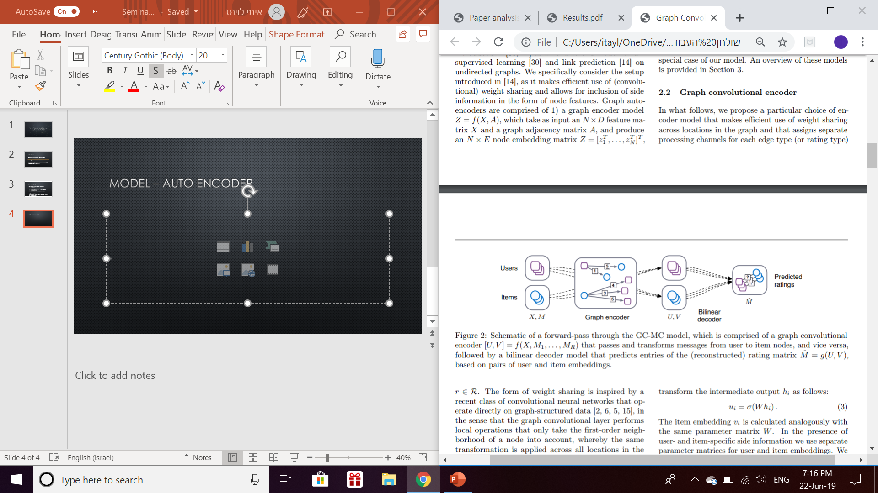
Model – Auto Encoder
The model uses the input matrices in an auto-encoder, to get latent features for users and items (Encoding). Then, the latent representation is used to reconstruct the adjacency matrix (Decoding).
In the training phase, the reconstructed matrix is taken to be as close to the original matrix as possible, using RMSE metric.s

Slide 5
Model – The Encoder Phase
The encoder model that worked best for the writers was made of two layers.
The first layer of two layers is a graph convolutional layer.
The next one is a simple dense layer.

Slide 6
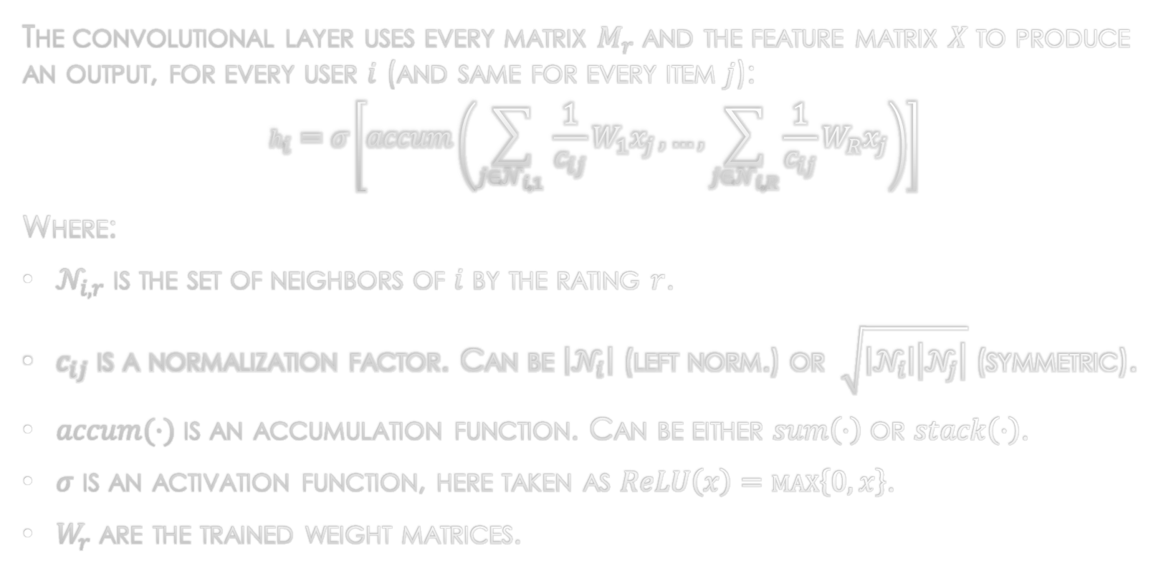
Model – The Encoder Phase
The convolutional layer uses every matrix $M_{r}$ and the feature matrix $X$ to produce an output, for every user $i$ (and same for every item $j$):
$$h_{i}=σ\left[accum\left(\sum_{j∈𝒩_{i, 1} }{\frac{1}{c_{ij}}W_{1}x_{j}}, …,\sum_{j∈𝒩_{i, R}}{\frac{1}{c_{ij}}W_{R}x_{j}}\right)\right]$$
Where:
$𝒩_{i, r}$ is the set of neighbors of $i$ by the rating $r$.
$c_{ij}$ is a normalization factor. Can be $\left|𝒩_{i}\right|$ (left norm.) or $\sqrt{\left|𝒩_{i}\right|\left|𝒩_{j}\right|}$ (symmetric).
$accum(⋅)$ is an accumulation function. Can be either $sum\left(⋅\right)$ or $stack\left(⋅\right)$.
$σ$ is an activation function, here taken as $ReLU\left(x\right)=\max\left\{0, x\right\}$.
$W_{r}$ are the trained weight matrices.

Slide 7
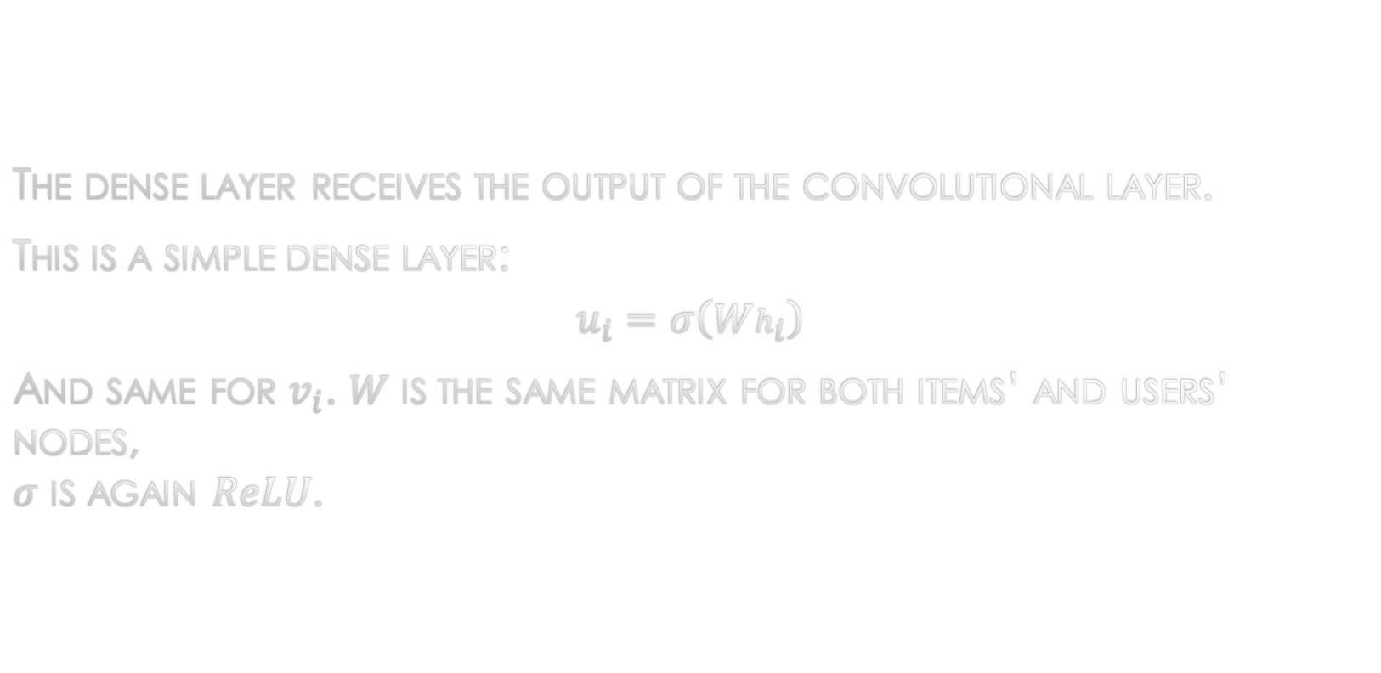
Model – The Encoder Phase
The dense layer receives the output of the convolutional layer.
This is a simple dense layer:
$$u_{i}=σ\left(Wh_{i}\right)$$
And same for $v_{i}$. $W$ is the same matrix for both items’ and users’ nodes, $σ$ is again $ReLU$.

Slide 8
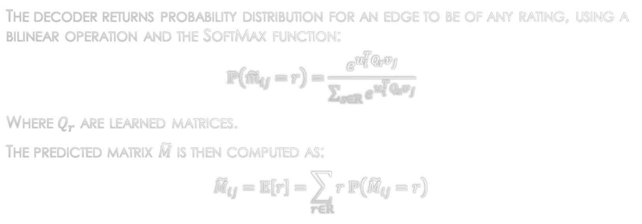
Model – The Decoder
The decoder returns probability distribution for an edge to be of any rating, using a bilinear operation and the SoftMax function:
$$ℙ\left({\tilde{m}}_{ij}=r\right)=\frac{e^{u_{i}^{T}Q_{r}v_{j}}}{\sum_{s∈R}{e^{u_{i}^{T}Q_{s}v_{j}}}}$$
Where $Q_{r}$ are learned matrices.
The predicted matrix $\tilde{M}$ is then computed as:
$${\tilde{M}}_{ij}=𝔼\left[r\right]=\sum_{r∈R}{r ℙ\left({\tilde{M}}_{ij}=r\right)}$$

Slide 9
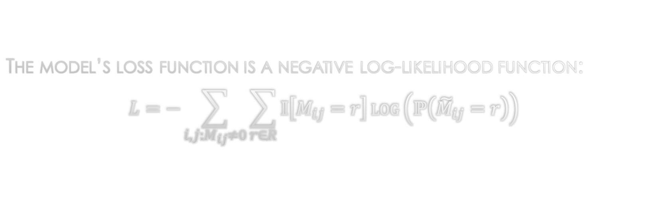
Training
The model’s loss function is a negative log-likelihood function:
$$L=−\sum_{i, j:M_{ij}≠0}{\sum_{r∈R}{𝕀\left[M_{ij}=r\right]\log\left(ℙ\left({\tilde{M}}_{ij}=r\right)\right)}}$$

Slide 10
Training
During training, dropout is used in two aspects:
Randomly dropping out all outgoing messages of one node with a constant probability.
Regular dropout over the hidden layer units.
In addition, for large datasets, mini-batching can be applied on the loss function – one can choose to summarize over some of the user-item pairs.

Slide 11
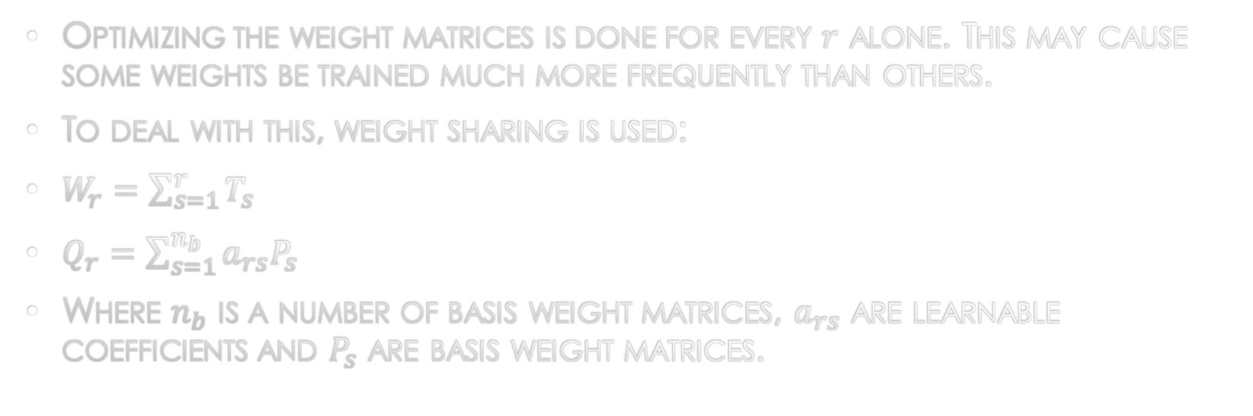
Training – weight sharing
Optimizing the weight matrices is done for every $r$ alone. This may cause some weights be trained much more frequently than others.
To deal with this, weight sharing is used:
$W_{r}=\sum_{s=1}^{r}{T_{s}}$
$Q_{r}=\sum_{s=1}^{n_{b}}{a_{rs}P_{s}}$
Where $n_{b}$ is a number of basis weight matrices, $a_{rs}$ are learnable coefficients and $P_{s}$ are basis weight matrices.
Notes:
W_r : the summary is until r. The larger r is, the more basic matrices it counts on.

Slide 12
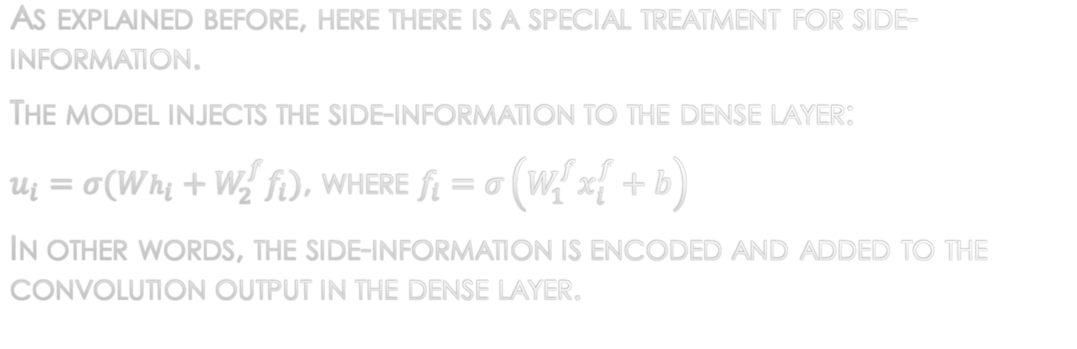
Side-information
As explained before, here there is a special treatment for side-information.
The model injects the side-information to the dense layer:
$u_{i}=σ(Wh_{i}+W_{2}^{f}f_{i})$, where $f_{i}=σ\left(W_{1}^{f}x_{i}^{f}+b\right)$
In other words, the side-information is encoded and added to the convolution output in the dense layer.

Slide 13
Summary – This paper’s novelty
This paper is the first to introduce graph auto-encoder of user and item nodes together.
It shows a new efficient way to include side-information.

Slide 14
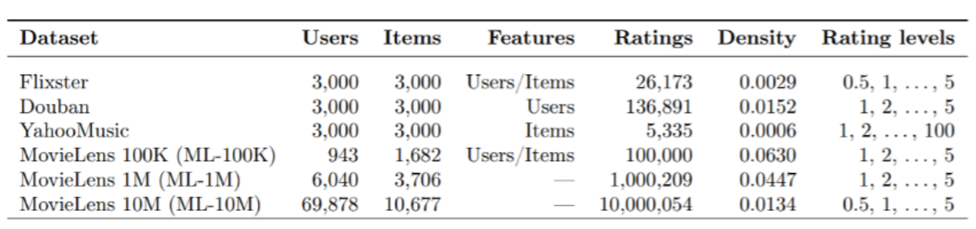
Experiments
The datasets in the paper are the following:

Slide 15
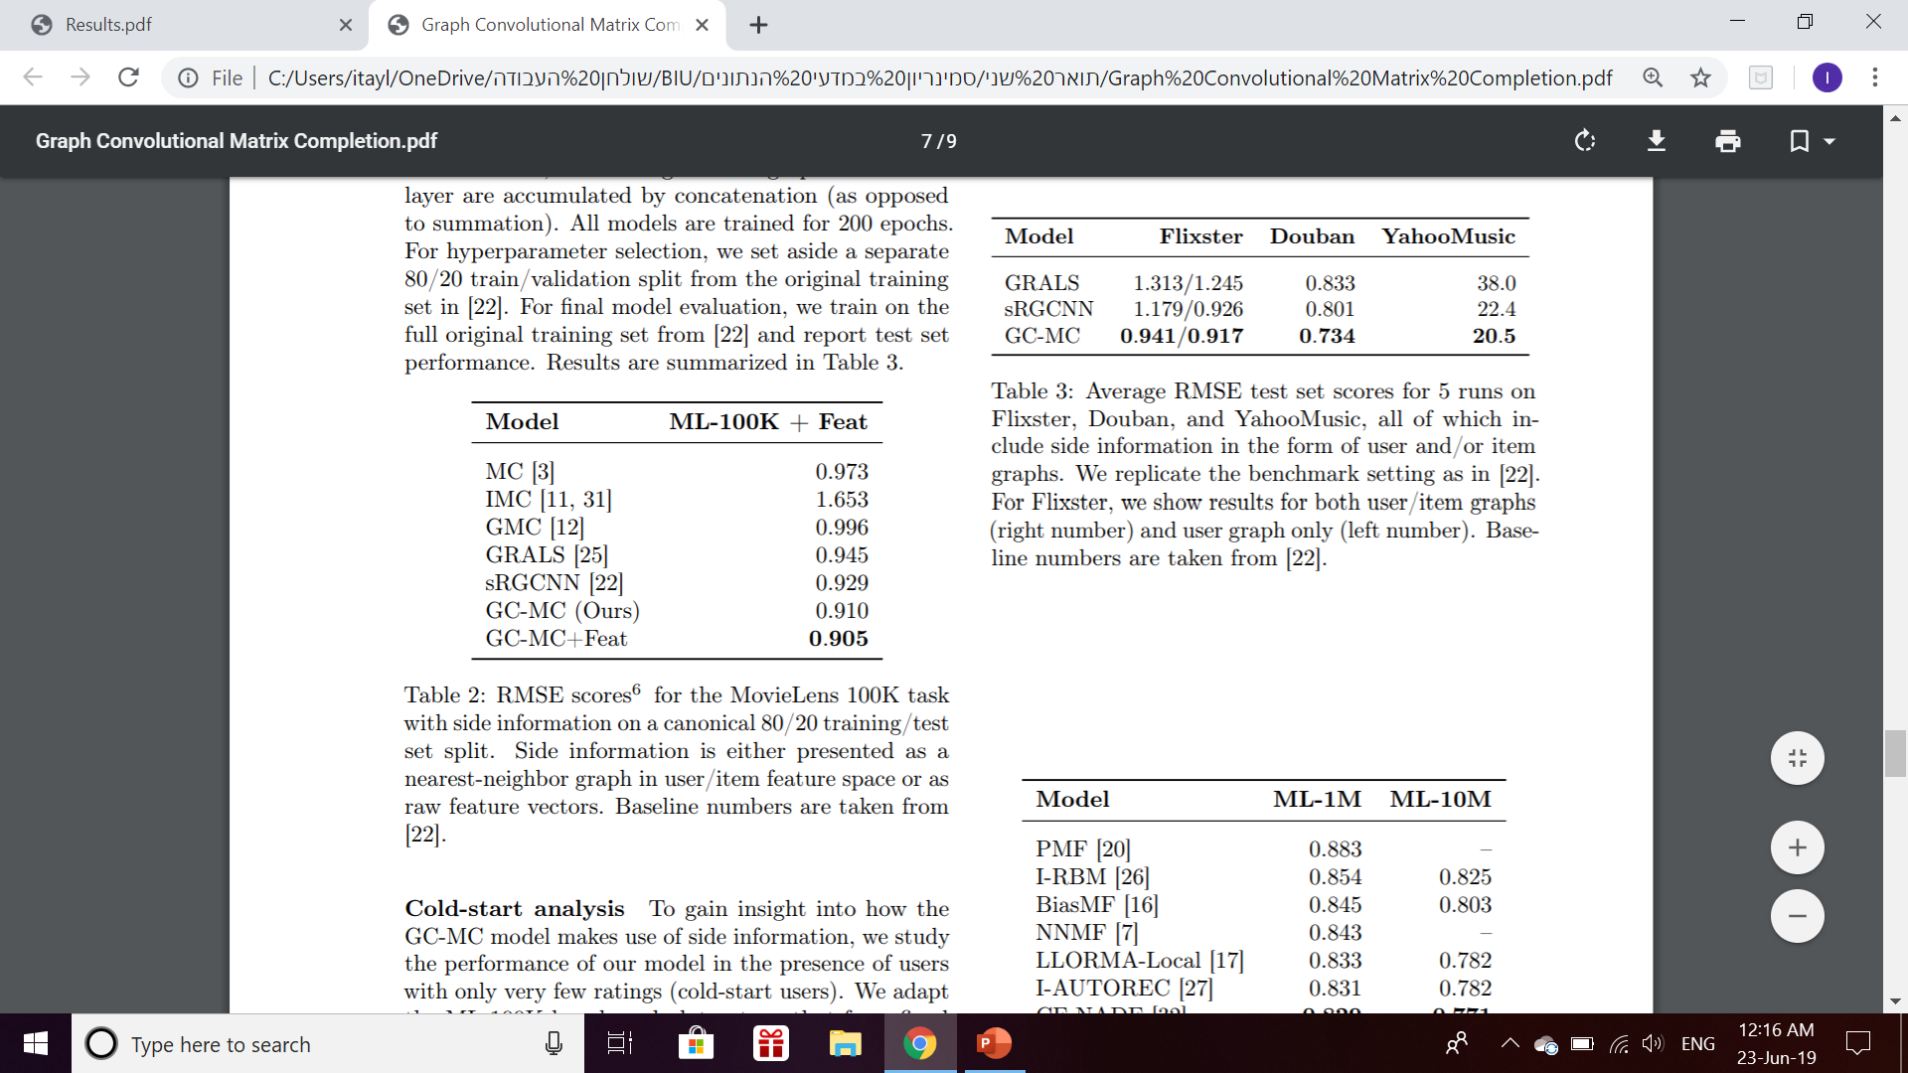
Experiments
Comparison between results of other methods to this:
Average RMSE test set scores for 5 runs
All include side-information
Settings are replicated to benchmarks.
For Flixster, the results for both user/item graphs (right number) and user graph only (left number).

Slide 16
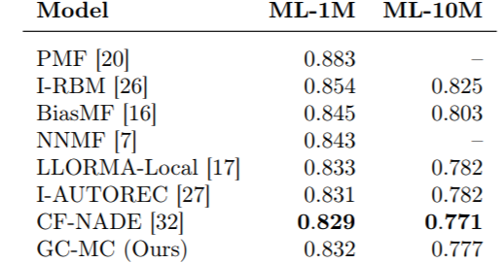
Experiments
Comparison between results of other methods to this:
Average RMSE test set scores over 5 runs
Left – with side-information. Also, GC-MC is a run without side-information
Right – some mini-batching is used, due to limited GPU memory.

Slide 17
Experiments
The new dataset – Book-Crossing dataset:
Originally, 278,858 users, 271,379 books, 1,149,780 ratings.
Filtering ages to 2-100.
Filtering books to match my format.
Filtering implicit rating
Keeping only users that rated enough (i.e. > 0.00005) of the books.
Used user features: Age. Used item features: Author name, year of publication.

Slide 18
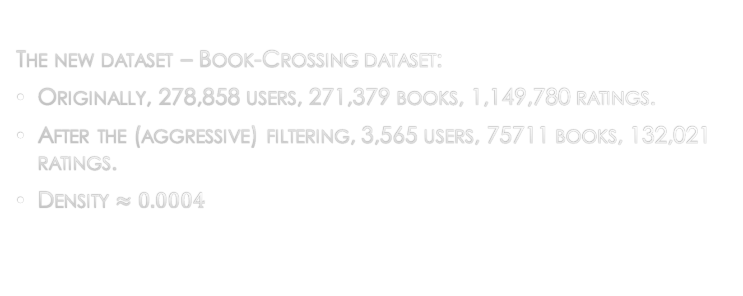
Experiments
The new dataset – Book-Crossing dataset:
Originally, 278,858 users, 271,379 books, 1,149,780 ratings.
After the (aggressive) filtering, 3,565 users, 75711 books, 132,021 ratings.
Density $≈0.0004$

Slide 19
Experiments
Parameter choice – not optimal, but a guess based on the other datasets.
This was not tested for 5 runs because every run took me 4 hours.
Training-test split: 90%-10%

Slide 20
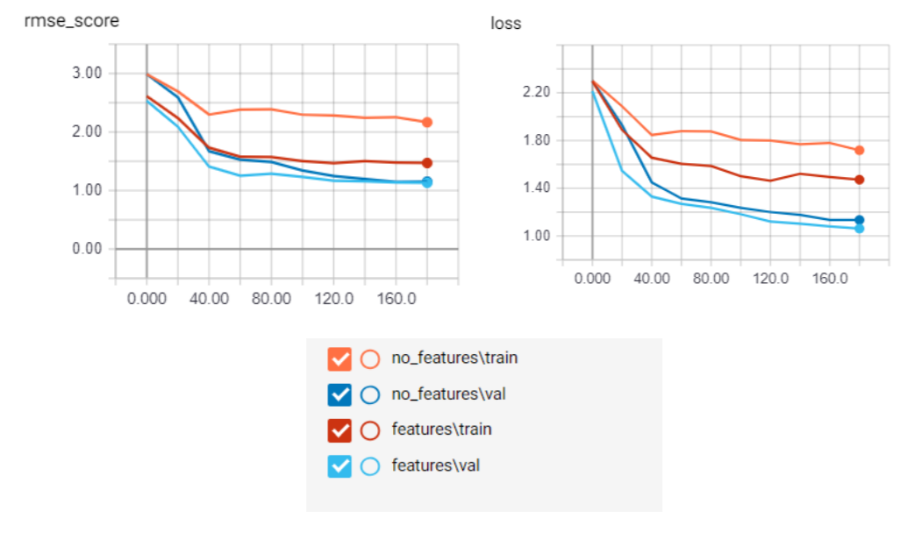
Experiments
On training and validation (i.e. 20% of training) sets:

Slide 21

Experiments
Final results on the test set:
Without side-information: loss $≈2.058$, RMSE $≈2.34$
With side-information: loss $≈1.7695$, RMSE $≈1.5815$

Slide 22
Experiments - Conclusions
The parameter choice was not optimal – An overfitting was observed.
Still, the model can learn.
The use of side-information benefits, but it caused the training take much longer (hours vs. minutes).
Without comparing to previous methods, no strong conclusion about the performances on this dataset.

